Slide 1

PROGRAMMING FOR DATA SCIENCE
Analysis of Nutrition, Physical Activity, and Obesity Trends
in the United States

Slide 2



Dataset Overview
Source: Behavioral Risk Factor Surveillance System (BRFSS), CDC.
Coverage: U.S. state-level public health data (from 2011).
Unit: State × Year × Population subgroup.
Key Measures: Obesity, physical activity, nutrition behaviors.
Demographics: Age, sex, education, income, race/ethnicity.
Data Fields: Prevalence estimate, confidence intervals, sample size.

Slide 3

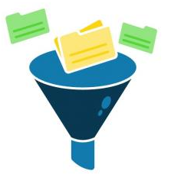
Data Cleaning
Why Cleaning is Needed: Real-world data has missing values and inconsistencies.
Steps Performed: Imported important libraries Loaded data into Data Frame Checked structure and missing values Selected relevant columns Cleaned and standardised data
Outcome: Clean, consistent dataset ready for analysis

Slide 4
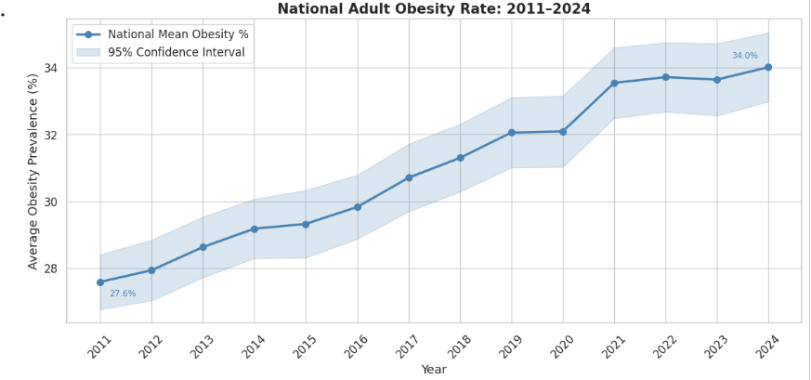

Obesity Trends Over Time
Obesity increased from 27.6% (2011) to 34.0% (2024)
Shows a steady upward trend over time.
Confidence interval indicates reliable estimates.
Highlights a growing public health issue
Notes :-
The rate increased steadily from 27.6% to 34%.
The shaded area shows the confidence interval..

Slide 5
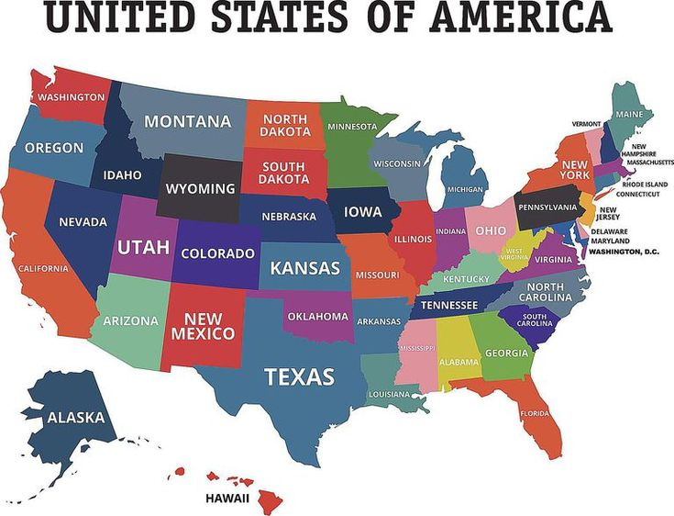
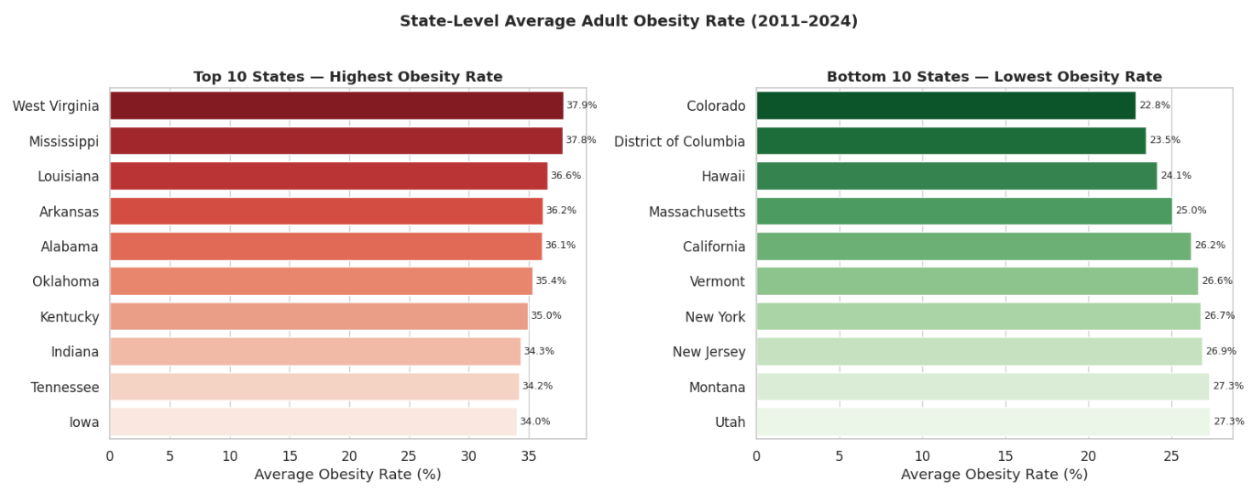
State-wise Obesity
Highest rates: West Virginia (37.9%),Mississippi(37.8%),Louisiana (36.6%).
Lowest rates: Colorado (22.8%), District of Columbia (23.5%), Hawaii (24.1%).
Shows large variation between states.
Notes :-
This chart compares the top 10 highest and lowest obesity states.
This highlights regional differences in lifestyle and health factors.

Slide 6
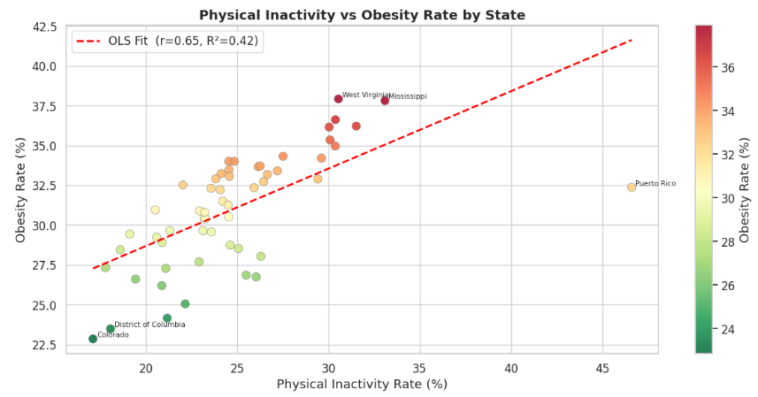


Physical Inactivity vs Obesity
Positive relationship: Higher physical inactivity is associated with higher obesity rates.
Strong correlation (r = 0.65) indicating inactivity significantly contributes to obesity..
Notes :-
The scatter plot shows that states with higher physical inactivity tend to have higher obesity prevalence.
This suggests that increasing physical activity could help reduce obesity rates.

Slide 7
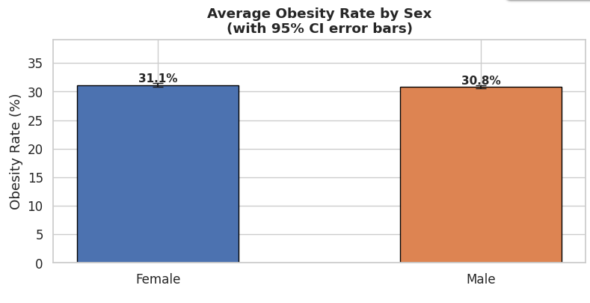
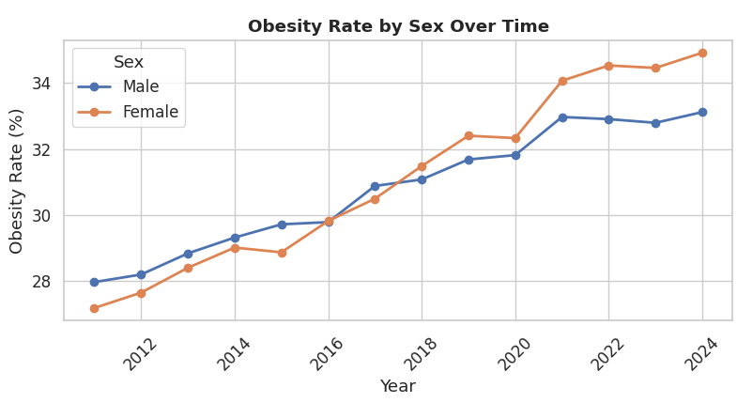
Obesity by Gender
Obesity increased for both males and females over time.
Females show slightly higher rates in recent years.
Average obesity rate: Female 31.1%, Male 30.8%.
Overall difference between sexes is small.
Note :-
Obesity rates have steadily increased for both males and females over time.
Females show a slightly higher average rate, but the overall difference between genders is small.

Slide 8
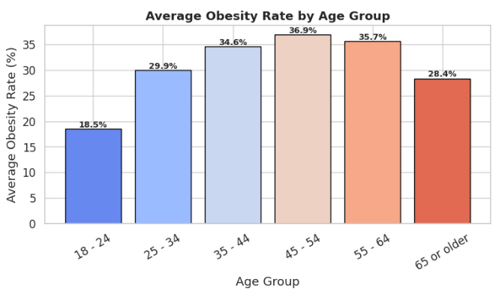
Obesity by Age Group
Obesity increases with age.
Highest rates in middle-aged adults (45–54).
Middle-aged adults are the highest-risk group.
Notes:-
Lifestyle and metabolic changes increase obesity in midlife.
This group should be targeted for interventions.

Slide 9
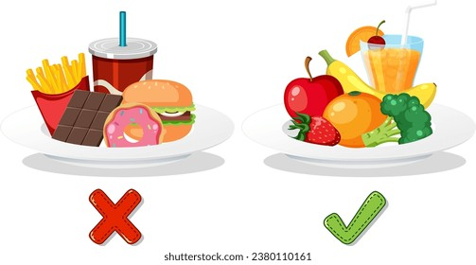
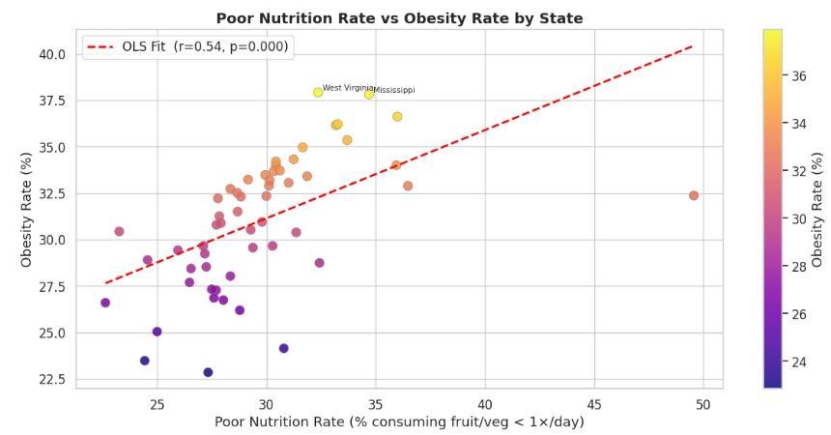
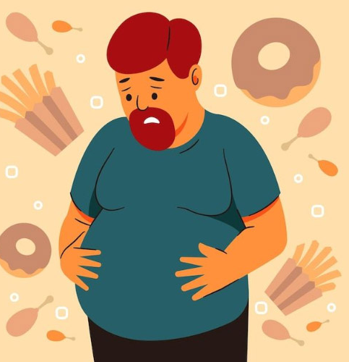
Poor Nutrition vs Obesity
Poor nutrition is linked to higher obesity rates.
Low fruit and vegetable intake correlates with obesity.
Diet quality is a major determinant of obesity.
Notes :-
As healthy food intake decreases, obesity increases.
Nutrition education is important for prevention.

Slide 10
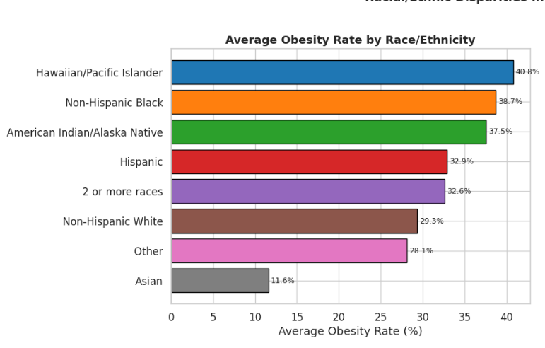
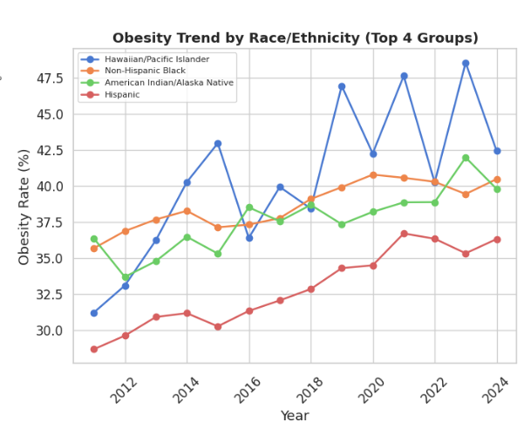
Obesity by Race / Ethnicity
Obesity rates vary significantly across ethnic groups..
Highest: Hawaiian/Pacific Islander (40.8%), Lowest: Asian (11.6%).
Notes :-
Some groups, especially Hawaiian/Pacific Islanders and Non-Hispanic Blacks, show higher obesity rates.
Asian populations have the lowest rates, highlighting ethnic health disparities.

Slide 11
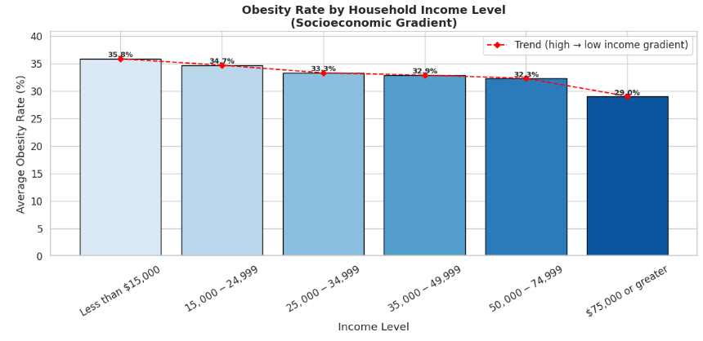
Obesity by Income
Obesity rates are higher in lower-income groups.
Highest: <$15,000 (35.8%), Lowest: ≥$75,000 (29.0%).
Shows a clear socioeconomic pattern.
Notes:-
Lower-income groups tend to have higher obesity prevalence.
Higher-income groups show relatively lower obesity rates.
Income may influence diet quality, lifestyle, and access to healthcare.

Slide 12
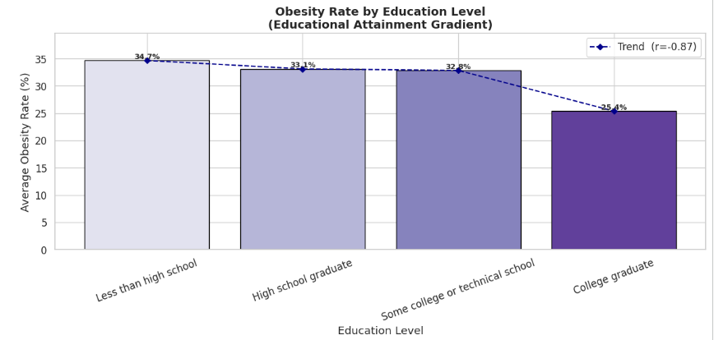
Obesity by Education
Obesity decreases as education level increases.
Highest: Less than high school (34.7%), Lowest: College graduates (25.4%).
Notes:-
People with lower education levels tend to have higher obesity rates.
Higher education may improve health awareness and lifestyle choices.

Slide 13

Coding Challenges
Challenges
Large dataset slowed loading and processing.
Inconsistent column names caused filtering/grouping errors.
Missing/non-numeric values affected calculations and charts.
Filtering sometimes returned empty datasets, causing errors.
Plots needed manual formatting and labeling.
Faster data loading and processing.
Correct filtering and grouping without errors.
Accurate calculations and valid charts.
No crashes from empty datasets.
Clear and well-labelled visualization.
Solutions

Slide 14
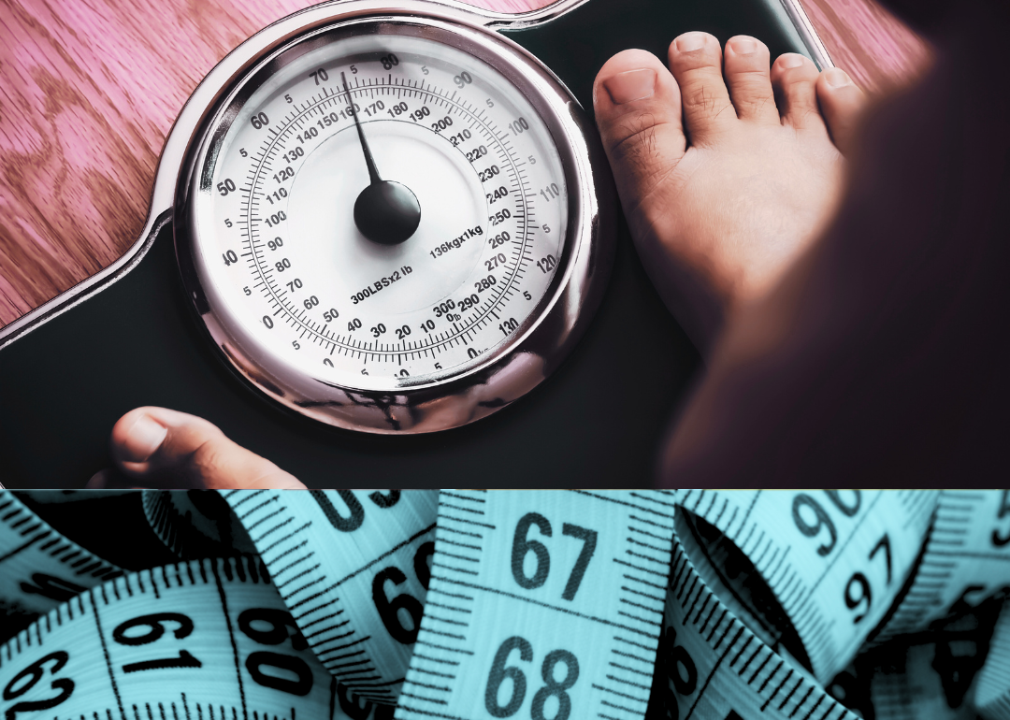

Conclusion
Data cleaning is essential for accurate analysis.
Diet, physical activity, age, and region strongly influence obesity.
Visualizations help identify trends.
Obesity is a growing public health issue-interventions need nutrition, activity, and targeted regional strategies.

